Slide 1
Subversion
CS 441, Spring 2020, Yongjie Zheng

Slide 2
About Subversion
Subversion
  A free/open source version control system
  A typical client-server model
  Uses the copy-modify-merge strategy
History
  Founded in 2000 by CollabNet, Inc. as a successor to CVS
  Became a top-level Apache project on February 17, 2010
  http://subversion.apache.org/
CS 441 Software Engineering

Slide 3
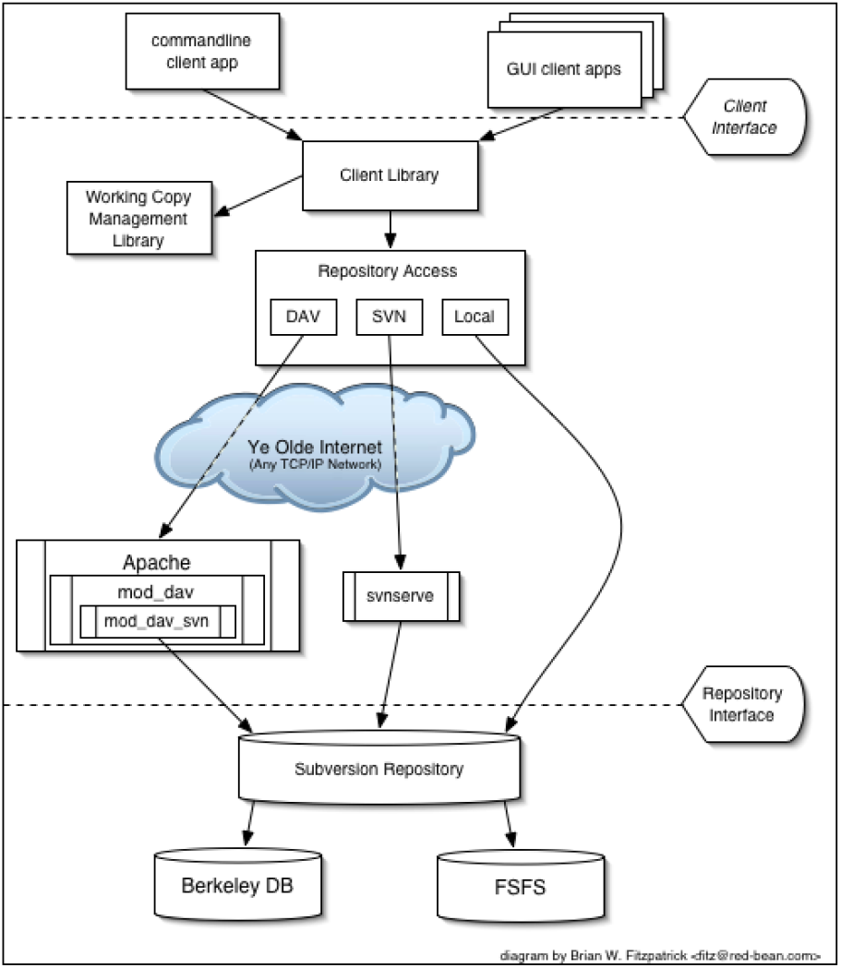
Subversion’s Architecture
A layered design
  Repository Layer
  Repository Access Layer
  Client Layer
CS 441 Software Engineering

Slide 4
Subversion’s Architecture
A modular design
  Implemented as a collection of libraries written in C
  Each library has a well-defined purpose and application programming interface (API)
  SVNKit vs. JavaHL
    JavaHL is the Java language binding provided by the Subversion project. Based on it, the Subversion libraries can also be used by Java applications.
    SVNKit is a pure Java implementation of the protocols used by Subversion, and does not use the Subversion libraries.
CS 441 Software Engineering

Slide 5
Using Subversion
Subversion Repository URLs
Working Copies
Revisions
Repository Administration
Basic Usage
CS 441 Software Engineering

Slide 6
Subversion Repository URLs
Schema | Access method
file:/// | Direct repository access (on local disk)
http:// | Access via WebDAV protocol to Subversion-aware Apache server
https:// | Same as http://, but with SSL encryption.
svn:// | Access via custom protocol to a svnserve server
svn+ssh:// | Same as svn://, but through an SSH tunnel.
A Subversion URL uses forward slashes on all platforms, including Windows.
  file:///var/svn/repos
  file:///C:/var/svn/repos
  svn://host/svn/repos
CS 441 Software Engineering

Slide 7
Working Copies
A private copy of the project for you
Also contains some extra files, created and maintained by Subversion: the .svn folder
  Which files contain unpublished changes
  which files are out of date with respect to others' work
  The .svn folder only exists in the topmost directory of a working copy from Subversion 1.7. In previous versions, it exists in every versioned subdirectory.
Created by the checkout operation
CS 441 Software Engineering

Slide 8
Revisions
Each time the repository accepts a commit, this creates a new state of the file system tree, called a revision.
Global Revision Numbers
  Subversion's revision numbers apply to entire trees, not individual files
  Revision N represents the state of the repository file system after the Nth commit
Mixed Revision Working Copies
  Every commit only increases the revision of the committed file.
  Your working copy may contain files from several different revisions after several commits.
  Revisions N and M of a file do not necessarily differ.
CS 441 Software Engineering

Slide 9
Repository Administration
Choose a Data Store
  Berkley DB vs. FSFS
  Prior to Subversion 1.2, the default was Berkeley DB; the default is now FSFS.
Recommended Repository Layout
  Three folders: trunk, branches, tags
Administrator’s Utilities
  svnadmin
  svnlook
  svndumfilter
  svnsync
CS 441 Software Engineering

Slide 10
Repository Administration
svnadmin Usages
  svnadmin SUBCOMMAND REPOS_PATH [ARGS & OPTIONS ...]
  Type 'svnadmin help <subcommand>' for help on a specific subcommand.
Examples
  svnadmin create /home/tom/svnrepository
  svnadmin create --fs-type bdb /home/tom/svnrepository
Note: svnadmin is a server-side utility.
  It is used on the machine where the repository resides.
  The path argument to svnadmin is a regular filesystem path and not a URL.
CS 441 Software Engineering

Slide 11
Basic Usage: svn
svn: the command-line client program
General Usages
  svn <subcommand> <options>
  The order of the subcommand and the options may vary
  Subcommands: add, checkout, commit, revert, …
  Options can have two different forms
    Long option: two hyphens followed by several letters and hyphens. (E.g. --fs-type, --verbose)
    Short option: a single hyphen followed by a single letter (E.g. -v).
Help!
  svn help <subcommand>
  Describes the syntax, options, and behavior of subcommand
CS 441 Software Engineering

Slide 12
Basic Usage: please note that
svn subcommands presented in the following slides are some most popular ones.
It is not an exhaustive list.
The sequence of presentation follows a basic work cycle of Subversion usage.
Refer to the svn manual (link is provided in the last slide) if you have question about how to use these subcommands.
CS 441 Software Engineering

Slide 13
Basic Usage
Getting data into your repository
Getting a working copy
Basic work cycle
  Update your working copy
  Make your changes
  Review your changes
  Fix your mistakes
  Resolve any conflicts
  Commit your changes
CS 441 Software Engineering

Slide 14
Getting data into your repository
Command: svn import
  Copy an unversioned tree of files into a repository and create intermediate directories as necessary.
  Recursively commit a copy of PATH to URL.
  Usage: svn import [PATH] URL
  Example: svn import myproj http://svn.com/repos
  To start working, you still need to svn checkout a fresh working copy of the tree.
CS 441 Software Engineering

Slide 15
Getting a working copy
svn checkout
  Check out a working copy from a repository.
  Usage: svn checkout URL[@REV]... [PATH]
  E.g. svn checkout file:///var/svn/repos/test mine
  If “PATH” information is not provided, svn checkout will create a working copy in a directory named for the final component of the checkout URL (“test” in the above example).
  If the local directory you specify does not yet exist, svn checkout will create it for you.
CS 441 Software Engineering

Slide 16
Basic work cycle
Update your working copy
  Involved command: svn update.
Make your changes
  Involved commands: svn add, svn delete, svn mkdir.
Review your changes
  Involved commands: svn status, svn diff.
Fix your mistakes
  Involved command: svn revert.
Resolve any conflicts (merge others’ changes)
  Involved commands: svn update, svn resolve.
Commit your changes: svn commit.
CS 441 Software Engineering

Slide 17
Update your working copy
It is a good practice to keep in touch with the repository (update often).
Command: svn update
  Bring your working copy into sync with the latest version in the repository.
  Resolves mixed revision working copies.
  Usage: svn update [PATH...]
  E.g. svn update
CS 441 Software Engineering

Slide 18
Making your changes
Two kinds of changes: file changes and directory changes.
You must tell Subversion about every directory change that you do by using the provided commands.
Command: svn add
  Schedule the file or directory to be added to the repository.
  Will be reflected to the repository in next commit.
  Usage: svn add PATH... (e.g. svn add testdir)
Command: svn delete (E.g. svn delete testdir)
Command: svn copy (E.g. svn copy testdir testdirCopy)
Command: svn move (E.g. svn move testdir newdir)
Command: svn mkdir (E.g. svn mkdir testdir)
  Same as: mkdir testdir; svn add testdir
CS 441 Software Engineering

Slide 19
Review your changes
See an overview of your changes: svn status – one of most popular svn commands
  svn status –verbose (-v): shows the status of every item in your working copy
    One column shows the working revision of the item.
    Another column shows the revision in which the item last changed.
Examine the details of your local modifications: svn diff
  The svn diff command displays differences in file content, with each line of text pre-fixed with a single-character code.
    A space: unchanged.
    A minus sign: how the line looked before the modifications.
    A plus: how the line looked after the modifications..
CS 441 Software Engineering

Slide 20
Fix your mistakes
svn revert
  Undo all local edits, and revert the file to its pre-modified state by overwriting it with the pristine version of the file.
    The pristine version is the version that the user checked out from the repository without making any changes.
  Usage: svn revert PATH...
  E.g. svn revert foo.c
CS 441 Software Engineering

Slide 21
Resolve any conflicts
When you run svn update, you may see conflict information displayed.
  “Conflict discovered in xxx …”
If conflict exists, you will be given several options to resolve the conflict. Overall, they can be classified as
  Viewing conflicts
    Display all changes or all conflicts (df or dc)
  Resolving conflicts
    Edit merged file in an editor (e)
    Accept my version for all conflicts or entire file. (mc or mf)
    Accept their version for all conflicts or entire file. (tc or tf)
  Postponing conflicts resolution
    Mark the conflict to be resolved later (p)
CS 441 Software Engineering

Slide 22
Resolve any conflicts
When postponing conflict resolution, three things will happen.
  Subversion prints a C during the update
  Subversion places conflict markers into the file to highlight the overlapping areas.
  For every conflicted file, Subversion creates three temporary files for it
    Filename.mine, filename.rOLDREV, filename.rNEWREV
Revolve by hand
After the conflicts are resolved
  svn resolve –accept working filename
  As a result, the temporary files will be removed and the file becomes commit-able.
CS 441 Software Engineering

Slide 23
Commit your changes
It is a good practice to explain your commits completely.
Command: svn commit
  Send changes from your working copy to the repository.
  Usage: svn commit [PATH...]
  E.g. svn commit -m "added howto section.”
  If you did not specify the message, Subversion will automatically launch your editor for composing a log message.
CS 441 Software Engineering

Slide 24
Additional useful commands
Command: svn log
  Shows information about the history of a working copy.
  You can also examine the history of a single file or directory.
  svn log foo.c
  svn log http://foo.com/svn/trunk/code/foo.c
Command: svn list
  Shows what files are in a repository directory without actually downloading the files to your local machine.
  svn list http://svn.example.com/repo/project
  svn list –v http://svn.example.com/repo/project
CS 441 Software Engineering

Slide 25
Reference
Please read Chapter 2 of the book “Version Control with Subversion”.
CS 441 Software Engineering

